Slide 1
System Development Methods CT046-3-2
Information Systems Development Methods

Slide 2
Topic & Structure of the lesson
Revisiting Information Systems (IS)
System Development Lifecycle (SDLC)
SDLC Phases
Information Systems (IS) Development Methodologies.

Slide 3
Learning Outcomes
By the end of this lecture, you should be able to :
Define Information Systems (IS) and describe its components.
Describe System Development Lifecycle (SDLC) and the SDLC phases.
Define IS methodologies.
Identify people involved in the development of IS.

Slide 4
Key Terms you must be able to use
If you have mastered this topic, you should be able to use the following terms correctly in your assignments and exams:
Information System (IS)
Systems Development Lifecycle (SDLC)
SDLC Phases
IS Methodologies
People involved in the development of IS

Slide 5
Information Systems (IS)

Slide 6
Information System (IS)
Definitions:
System
Interrelated components functioning together to achieve an outcome.
Information System
Collection of interrelated components that collect, process, store, and provide as output information needed to complete tasks (Satzinger, et al., 2015).
An information system is a set of related components that produces specific results (Shelly and Rosenblatt, 2012).
An information system is an arrangement of people, data, processes, communications, and information technology that interact to support and improve day-to-day operations in a business, as well as support the problem-solving and decision-making needs of management and users (Whitten, et al., 2005)

Slide 7
Information Systems (IS) Components
An information system has five key components: hardware, software, data, processes, and people.
Hardware consists of everything in the physical layer of the information system.
For example, hardware can include servers, workstations, networks, telecommunications, equipment, fibre-optic cables, mobile devices, scanners, digital capture devices, and other technology-based infrastructure.

Slide 8
Information Systems (IS) Components Cont.
Software refers to the programs that control the hardware and produce the desired information or results.
Software consists of system software and application software.
System software manages the hardware components. Examples: the operating system, security software that protects the computer from intrusion, device drivers that communicate with hardware such as printers, and utility programs that handle specific tasks such as data backup and disk management.
Application software consists of programs that support day-to-day business functions and provide users with the information they require. Examples of company-wide applications, include order processing systems, and payroll systems.

Slide 9
Information Systems (IS) Components Cont.
People who will interact and use the system.
People who have an interest in an information system are called stakeholders. Stakeholders include the management group responsible for the system.
The users (sometimes called end users) inside and outside the company who will interact with the system.
IT staff members, such as systems analysts, programmers, and network administrators who develop and support the system.

Slide 10
Information Systems (IS) Components Cont.
Data is the raw material that an information system transforms into useful information.
An information system can store data in various locations, called tables. By linking the tables, the system can extract specific information.
Processes/Procedures describe the tasks and business functions that users, managers, and IT staff members perform to achieve specific results.
Processes are the building blocks of an information system because they represent actual day-to-day business operations.

Slide 11
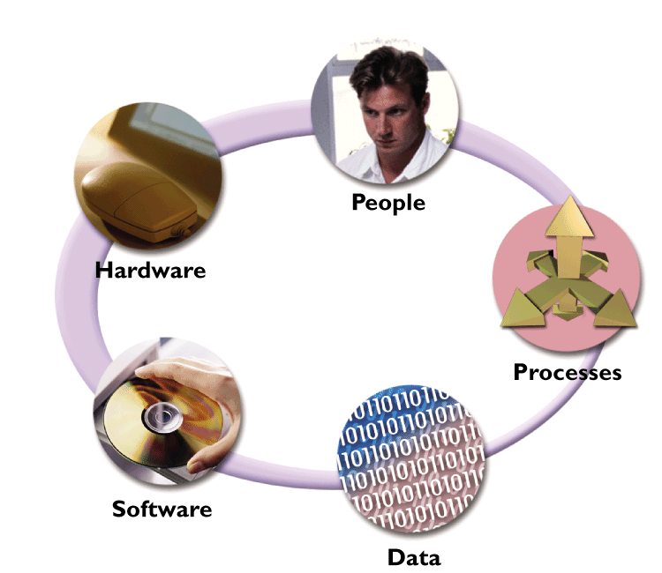
Information System (IS) Components Cont.
People who will interact and use the system includes technical and non-technical people.
All physical components of the information system.
Describes the tasks and business functions that users, managers, and IT staff members perform to achieve specific results.
Programs that control the hardware and produce the desired information or results.
The raw material that an information system transforms into useful information.

Slide 12
The Importance of Information Systems
Reasons why information systems are important for businesses:
To make the information accurate, that can be quickly accessed on demand.
An effective information system can entitle an organization with better planning, decision-making and hence desired results.
Constantly being developed to make business more competitive, impact productivity and profits
Keys to successful information systems development:
Thorough systems analysis and design
Understanding what business requires

Slide 13
System Development Lifecycle (SDLC)

Slide 14
Systems Development Life Cycle (SDLC)
Definitions:
System development lifecycle (SDLC) is the entire process consisting of all activities required to build, launch, and maintain an information system (Satzinger, et al., 2015).
SDLC is a series of phases to plan, analyze, design, implement, and support an information system (Shelly and Rosenblatt, 2012).
A simplified definition – SDLC is a GENERAL RECEPIE to ‘cook-up’ an Information System.

Slide 15
Facts about SDLC
SDLC acts as the basis for System Development Methodologies (SDM)
SDLC is not IS Development Methodology
SDLC can be generally used to manage any IT-based projects.
SDLC has techniques to guide a developer and provides the overall framework for managing systems development process.
Identify the problem or need and obtain approval
Plan and monitor the project
Discover and understand the details of the problem or need
Design the system components that solve the problem or satisfy the need
Build, test, and integrate the system components
Complete system tests and then deploy the solution

Slide 16
SDLC and Problem Solving
Project Planning
Analysis
Design
Implementation
Organization recognizes problem
Project team investigates, understands problem and solution requirements
Solution is specified in detail
System that solves problem is built and installed
Support
System used, maintained, and enhanced to continue to provide intended benefits

Slide 17
SDLC Phases

Slide 18
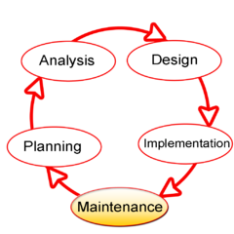
Systems Development Life Cycle (SDLC)
SDLC shows main stages:
PLANNING
ANALYSIS
DESIGN
IMPLEMENTATION
MAINTENANCE
(if any major problems, then back to planning)

Slide 19
PHASE-1 – Planning
System Planning sub-phases:
Define business problem and scope
Produce detailed project schedule
Project initial and feasibility studies
Economic, organizational, technical, resource, and schedule
Staff the project (resource management)
Launch project → official announcement
Input: Problem Statements
Output: Feasibility Study Report, Initial Study Report, Project Proposal.
PLANNING
ANALYSIS
DESIGN
IMPLEMENTATION
MAINTENANCE

Slide 20
PHASE-2 – Analysis
System analysis sub-phases:
Gather information to learn problem domain
Define system requirements
Prioritize requirements
Generate and evaluate alternatives
Review recommendations with management
Popular techniques used:
Data Mining
Data visualization
Statistical Analysis
Input: Feasibility Study Report, Initial Study Report, Project Proposal.
Output: System Requirement Specification (SRS)
PLANNING
ANALYSIS
DESIGN
IMPLEMENTATION
MAINTENANCE

Slide 21
PHASE-3 - Design
System Design sub-phases:
Design and integrate the network
Design the application architecture
Design the user interfaces
Design the system interfaces
Design and integrate the database
Prototype for design details
Design and integrate system controls
Popular techniques used: Conceptual Design, Logical design, Data Design / Modeling, Physical Design.
Input: System Requirement Specification (SRS)
Output: Design Specification
PLANNING
ANALYSIS
DESIGN
IMPLEMENTATION
MAINTENANCE

Slide 22
PHASE 4 – Implementation
System Implementation sub-phases:
Construct software components
Verify and test Convert data
Train users and document the system
Install the system
Popular techniques used: Unit testing, integration testing, user acceptance testing, etc.
Input: Design Specification
Output: Fully functional system
PLANNING
ANALYSIS
DESIGN
IMPLEMENTATION
MAINTENANCE

Slide 23
PHASE 5 – Review and Maintenance
System Maintenance sub-phases:
Maintain system: Small patches, repairs, and updates
Enhance system: Small upgrades or enhancements to expand system capabilities
Support users: Help desk and/or support team
Types of Maintenance:
Corrective - deals with the repair of faults or errors found in day-today system functions.
Preventive - implementing changes to prevent the occurrence of errors.
Adoptive - concerned with the change in the system that takes place to make the system adaptable to new environment such as to run the IS on a new operating system.
Perfective - concerned with the change in the system that happens while adding new functionalities in the system.
PLANNING
ANALYSIS
DESIGN
IMPLEMENTATION
MAINTENANCE

Slide 24
Information Systems (IS) Development Methodologies.

Slide 25
What is IS Development Methodology?
Definition:
“A software development methodology or system development methodology in software engineering is a framework that is used to structure, plan, and control the process of developing an information system”.
Simplified Definition:
A Specific Recipe to ‘cook-up’ a specific type of Information System
(In comparison to SDLC which viewed as GENERAL recipe)
Contains detailed steps to be carried out at specific situations / specific type of project.
SDLC acts as the basis for IS Development Methodology.

Slide 26
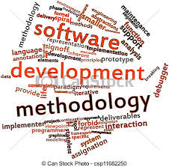
What is Systems Development Methodology ?
Some popular IS Development Methodologies
Waterfall Model – most basic methodology close to the SDLC
Structured Systems Analysis And Design Methodology (SSADM) – used for large database projects
Web Information Systems Development Methodology (WISDM) - used for web-based projects
Spiral – used for project which has many sections but need to be linked later.
Rapid Application Development (RAD) – used for
small and fast projects
Extreme Programming (XP) - For advance / heavy
coding projects

Slide 27
What makes up an IS Development Methodology ?
A Methodology includes a collection of techniques and tools that are used to complete activities and tasks, including modelling, for every aspect of the project.
Satzinger, Jackson and Burd (2012)

Slide 28

What makes up an IS Development Methodology ?
Methodologies use TOOLS and TECHNIQUES to carry out tasks.
TOOLS – often CASE TOOLS includes any use of computer-based support in the software development, help to simplify the task.
Testing Tool to test other software.
Code Generator to generate programming codes from design.
TECHNIQUES - different ways of doing things.
Prototyping – A model of the system developed to get feedback
JAD - Meeting session for a group of users, managers and IT professionals to gather information, discuss business needs, and define the system requirements.
Fact-finding using techniques such as interviews, surveys,
document review, observation, and sampling.

Slide 29
Methodologies
Represent some aspect of the system
Software applications to create project components
Guidelines to help an analyst complete a task
Models
Examples:
Flowchart
Use Case Diagram
Class Diagram
Gantt Chart
Organization Chart
Techniques
Tools
Examples:
Visual Modelling tool
Integrated Development Environment
Word Processor
Automated Testing Tool
Code Generator
Examples:
Interviewing
Techniques
OO programming techniques
Data Modelling Techniques
Software Testing Techniques

Slide 30
People involved in the Development of IS
A stakeholder is any person who has an interest in an existing or new information system. Stakeholders can be technical or nontechnical workers.
For information systems, the stakeholders can be classified as:
System owners
System users
Systems analysts
Project Manager
System developers
System testers
System administrators

Slide 31
People involved in the Development of IS (Cont.)
System Owners are people who pay and own the system
User are people who directly/indirectly use the new system
System Analysts are people who must understand business processes and document them carefully.
Project Manager is responsible for knowing the “who, what, where, when and why” of the software project. This means knowing the stakeholders of the project and being able to effectively communicate with each of them.
Developers are responsible for using the technical requirements for building the deliverables and communicating the status of the software project to the Technical Lead or Project Manager.
System Testers ensure that the software solution meets the business requirements and that it is free of bugs, errors and defects.
System Administrators: are people who ‘take-care’ of the system after it is done

Slide 32

Importance of using IS Development Methodology
To ensure consistency in the management of projects
To ensure the best techniques applied to carry out a project.
Reduce time & cost
To improve the quality of work & system
Meet user requirement

Slide 33
Summary
Information systems are important for businesses to make the information accurate, provide better planning, decision-making and make business more competitive.
The keys to successful information systems development are thorough systems analysis and design.
SDLC is a series of phases to plan, analyze, design, implement, and support an information system, and acts as the basis for SDM.
SDM Contains detailed steps to be carried out in specific situations / specific types of projects. It uses various tools and techniques to carry out tasks.
Stakeholders are people who have an interest in an information system and include technical or non-technical people.
SDM helps to ensure consistency in the management of projects, the best techniques applied to carry out a project, meet user requirements. Besides, it helps to reduce time & cost and improve the quality of work & system.

Slide 34
Question & Answer

Slide 35
Next Session
Structured Methodologies.

Slide 36
References
Satzinger, J. W., Jackson, R. B., & Burd, S. D. (2015). Systems Analysis and Design in A Changing World. Cengage learning.
Shelly, G. B., & Rosenblatt, H. J. (2012). Systems Analysis and Design. Boston, MA: Course Technology.
Whitten, J. L., Bentley, L. D., & Dittman, K. C. (2005). Systems Analysis and Design Methods (7th Ed.). McGraw-Hill/Irwin

